Slide 1
Cogent Lecture 1
An introduction to Cogent
Designing psychological experiments in
MATLAB using Cogent toolboxes
James Bisby
23rd Nov 2017
Course Material: http://www.icn.ucl.ac.uk/
Cogent Software: http://www.vislab.ucl.ac.uk/cogent.php

Slide 2
Autumn/Winter Term – Cogent
2:00pm Thurs 23rd Nov An introduction to Cogent 2000
2:00pm Thurs 30th Nov Logging responses, script logic etc.
2:00pm Thurs 7th Dec Cogent Graphics and external devices
10:00am Mon 4th Dec Practical 1 – Cogent 2000
10:00am Mon 11th Dec Practical 2 – Cogent Graphics
Course Materials
https://www.ucl.ac.uk/icn/study/matlab-course/index

Slide 3
Background
Cogent – MATLAB toolbox for stimulus presentation etc. (i.e., running your psychology experiment)
Other software: Psychtoolbox (also in MATLAB), E-prime (windows-based; costs money!), Presentation (script-based; costs money!).
Two separate toolboxes in one:
Cogent2000 – use for stimulus presentation, collection of responses etc. – Cogent lecture 1 & 2 covers this!
Cogent graphics – use for generating simple graphics in real-time – Cogent lecture 3 covers this!

Slide 4
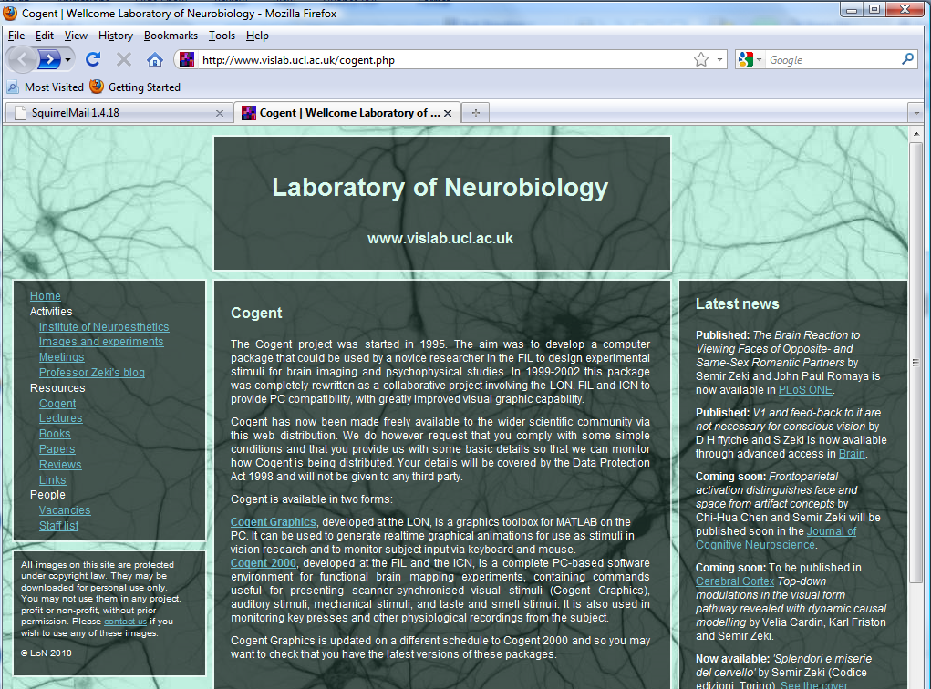
Getting Cogent Toolboxes

Slide 5
Downloading Cogent
Download toolbox from website
http://www.vislab.ucl.ac.uk/cogent.php
Cogent2000 v1.32 contains three folders:
Documents Manuals & information on functions
Toolbox All the functions
Samples Exemplar files. Shows what functions can do & good for to cribbing scripts

Slide 6
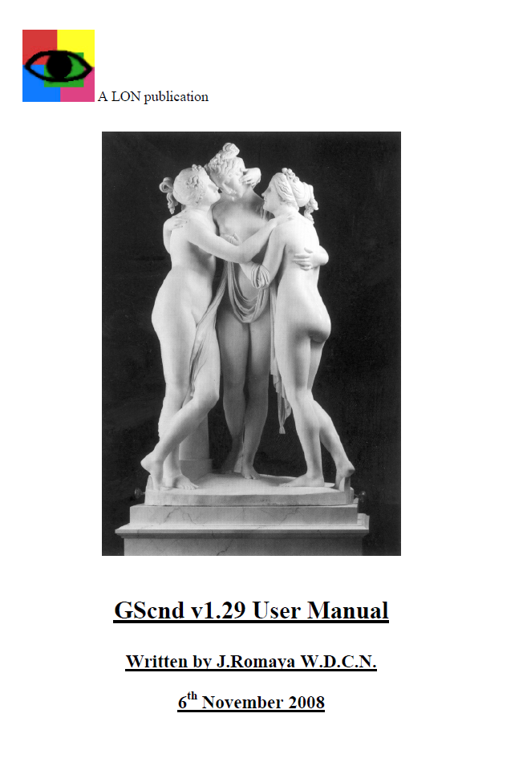
Cogent Graphics
Manual
- Documents\G2UsrManv132.pdf
updates from previous versions
compatibility issues
set-up procedures
explains all functions (‘cg’ prefix)
This is a stand alone toolbox
Very useful for drawing visual stimuli

Slide 7

Cogent2000
Manual
- Documents\G2UsrManv125.pdf
Cogent2000 developed at FIL & ICN
present visual, auditory & tactile
record user responses
interact with external devices
Depends on Cogent Graphics
both Cogent2000 & Cogent graphic commands in toolbox folder

Slide 8
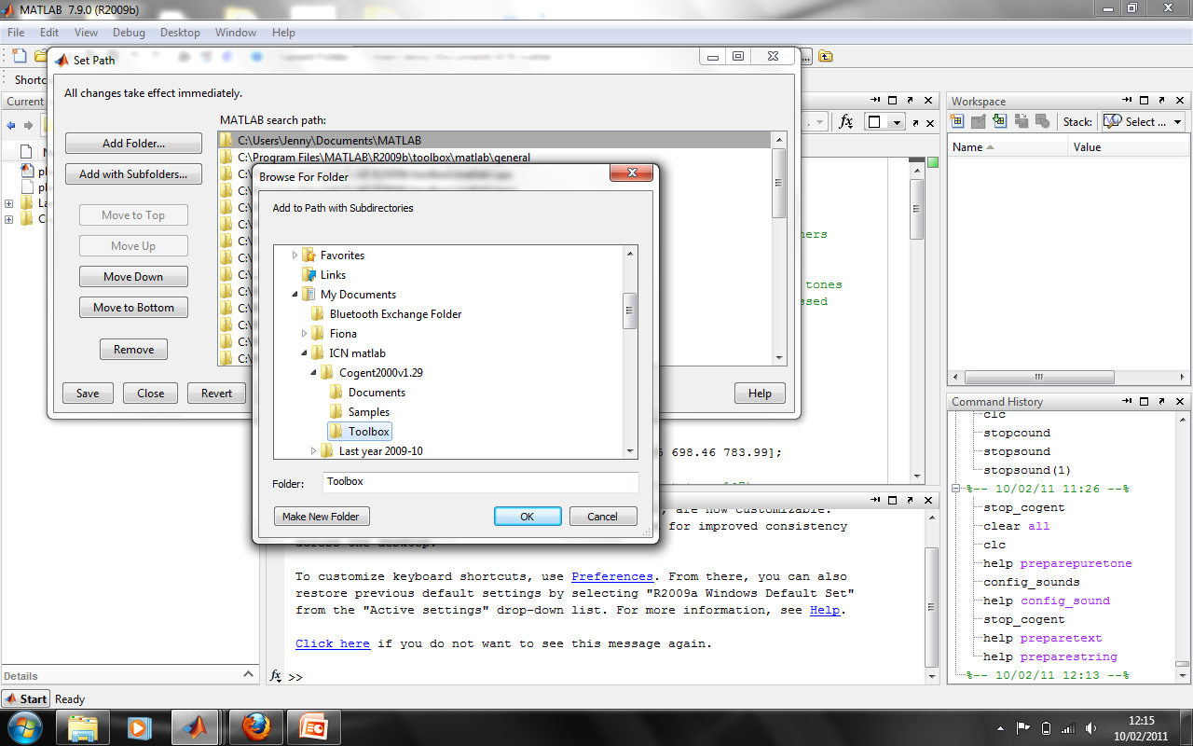
Setting the path
File ➔ Set path ➔ ..\Cogent200v1.29\Toolbox

Slide 9
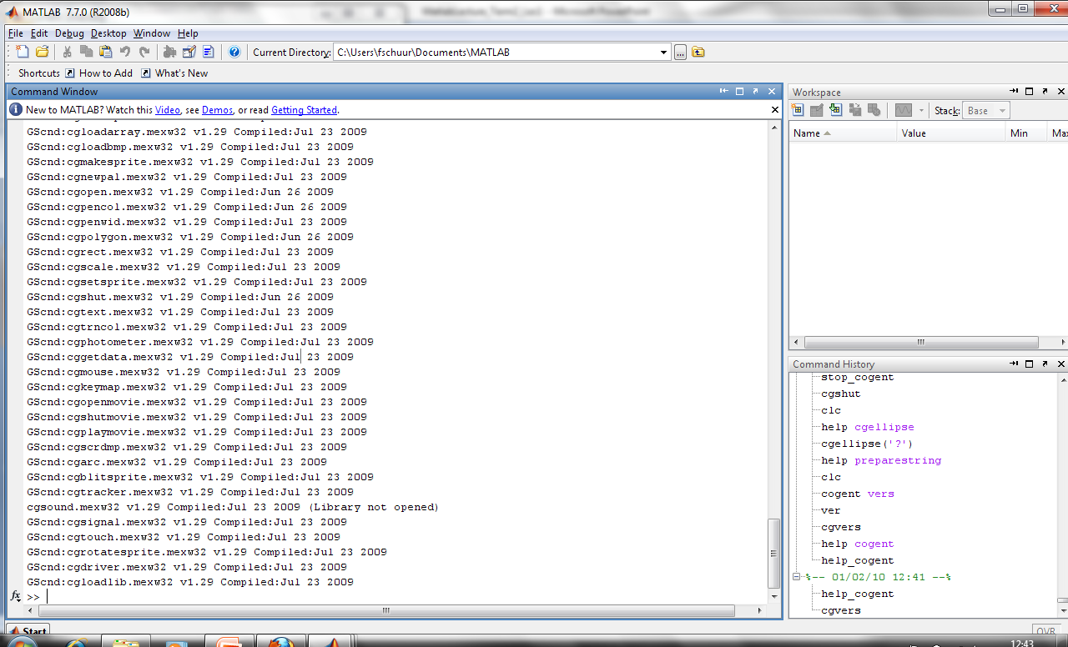
Check
Cogent 2000: help_cogent
Cogent graphics: cgvers

Slide 10
Aims: Lecture 1 & 2
Become competent in Cogent (i.e., self-sustaining)
Organising an experimental script
How to configure Cogent prior to starting an experiment
How to present a:
String
Image
Sound
Making a trial loop
Randomising stimulus presentation
Presenting multiple stimuli in different locations on the screen
Recording of experimental variables (e.g., stimulus time; location etc.) from trial to trial
Collecting and recording key-presses
Making presentation contingent on key-presses
Turn your experimental script into a function

Slide 11
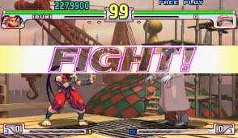
Cogent 2000 vs Cogent Graphics
Cogent 2000 is a MATLAB Toolbox for presenting stimuli and recording responses with precise timing.
Cogent 2000 is great if your experiment is simple e.g. just presenting bitmaps or text.
The commands are intuitively named (e.g. preparestring, loadpic, drawpic etc.) so it’s very easy to learn.
Cogent 2000 comes with ten sample scripts in the standard download that cover presenting stimuli at specific times and logging responses.
But what if your stimuli are more complex? Cogent 2000 is quite limiting.
Cogent Graphics is a stand-alone library of graphics functions that allows the user to present sophisticated graphical stimuli from MATLAB.
Cogent 2000 commands actually really call Cogent Graphics “under the bonnet”.
In my opinion it’s worth scripting with Cogent Graphics from the start.
Notes:
What if your stimuli aren’t bitmaps or text, what if you need to draw shapes? What if the shapes need to change on every trial? What if you want to present a bitmap, but the attributes of the bitmap need to change on every trial? What if you’re running a psychophysics experiment and you need to generate and present a gabor patch?
Well, there’s a suite of graphics functions called cogent graphics that you can use in conjunction with or in place of the cogent 2000 commands.

Slide 12
Organising an experimental script
A script is a set of instructions executed sequentially once run. They can be written in the MATLAB editor and saved as .m files
You can also turn your experiment script into a function – see later (excitement builds)
A typical script:
Define variables for experiment (stimuli to present etc.)
Configure cogent (display, keyboard settings etc.)
Run the experiment:
Present stimuli
Record key-presses
Finish experiment (save results etc.)

Slide 13
Organising an experimental script
Creating empty variables and structures that you are going to call later on in the script so that you avoid hard coded values e.g.
p. numtrials=40;
p.times.stim=1000;
p.times.fixation=500;
p.times.blank=2000;
p.stim={‘image.bmp’};
etc.
This involves MATLAB programming skills and a bit of thought and isn’t anything specific to Cogent.
Initialising expt. variables
Initialising expt. variables
Configuration of devices
start_cogent
Run experiment
load premade stimulus files
create new stimuli
trial loop:
- present stimuli
- get user responses
- save data as you go
save final data & close files
stop_cogent

Slide 14
Organising an experimental script
Configure all devices required before you start_cogent
config_display;
config_sound;
config_keyboard;
config_mouse;
config_serial;
config_log;
config_data;
config_results;
To find out more about a config function type: help config_xxx
Initialising expt. variables
Configuration of devices
start_cogent
Run experiment
load premade stimulus files
create new stimuli
trial loop:
- present stimuli
- get user responses
- save data as you go
save final data & close files
stop_cogent

Slide 15
Configure Cogent
config_display (mode, resolution, background, foreground, font, fontsize etc)
Start with this!
Configures the display
You don’t have to specify everything – if you use ‘config_display’ it will revert to default options
config_keyboard
Configures the keyboard
Again, has a few options, but you will most likely use the default so use ‘config_keyboard’
Also: ‘config_sound’ for auditory stimuli, ‘config_results’ to set the filename for the results file and ‘config_serial’ to connect to external devices (for example if you are running at fMRI study – see 3rd lecture on Cogent)

Slide 16
Organising an experimental script
Start cogent after config_ but before stimuli created/presented
start_cogent
Initialising expt. variables
Configuration of devices
start_cogent
Run experiment
load premade stimulus files
create new stimuli
trial loop:
- present stimuli
- get user responses
- save data as you go
save final data & close files
Stop cogent after all stimuli end, responses logged & data saved
stop_cogent
stop_cogent

Slide 17
Organising an experimental script
Initialising expt. variables
Configuration of devices
start_cogent
Cogent 2000 commands
Run experiment
load premade stimulus files
create new stimuli
trial loop:
- present stimuli
- get user responses
- save data as you go
save final data & close files
‘preparestring(text, buffer, x, y)’
‘loadpict(filename, buffer, x, y)’
‘loadsound(filename, buffer)’
‘drawpict(buffer)’
‘playsound(filename, buffer)’
‘wait(time)’
‘waituntil(time)’
stop_cogent

Slide 18
Display a string/image/sound
Buffers:
All stimuli should first be loaded into a ‘buffer’ (prepare…)
Once loaded the stimulus can they be presented (display…)
Present a string:
A string is a sequence of letters in MATLAB – in the case of your experiment, this will probably be a word
preparestring(text, buffer, x, y); drawpict(buffer);
Present an image:
Load an image into a buffer (e.g., a .jpg or .bmp) and then display
loadpict(filename, buffer, x, y); drawpict(buffer);
Present a sound
Same logic as presenting an image
loadsound(filename, buffer); playsound(buffer);

Slide 19
Example 1: presenting one image

Slide 20
Creating a trial structure
Now we can display single stimuli we can:
Create a trial structure (fixation cross, stimulus, blank-screen)
‘wait(duration)’
Create a loop to run this trial sequence multiple times
Trial sequence:
Prepare all stimuli for presentation (buffers)
Present all stimuli in sequence
Loop it:
for trial = 1:p.ntrials % start trial loop (structures!)
Insert trial structure % trial sequence
end % end trial loop

Slide 21

Creating a trial structure
1000ms fixation
1000ms image
1000ms blank

Slide 22
Example 2: creating a trial structure

Slide 23
Randomising stimulus presentation
Now we can present a single trial multiple times we want to:
Present a different stimulus (e.g., image) on each trial
Randomise the presentation order each time we run the script
At start of script (in ‘define experimental variable’) set all the filenames for each image you want to present:
exp.stim.fname = {‘pic1.bmp’; ‘pic2.bmp’; ‘pic3.bmp’; ‘pic4.bmp’}
In loop, make load_pict dependent on trial number
loadpict(p.stim{trial}, buffer)

Slide 24
Randomising stimulus presentation
There’s more than one way to randomise presentation order!
Choose the best method to suit your needs (think before you start coding)
First (always) make sure random numbers are random
rng(‘shuffle’) – seeds random number generator based on current time (depends on MATLAB version – old version ‘rand(‘state’, sum(100*clock))’)
You opt for see this way:
p.ord = randperm(p.ntrials)
loadpict(p.stim{p.ord(trial)}
But I prefer this way:
First make a cell array (e.g. p.stimlist) containing all the useful information about your trials in different columns (e.g. stimulus file, type, condition etc…)
Add a column to the end of this cell array that contains random numbers
Sort the cell array by the random number and rename (e.g. p.randstimlist)
In a loop, make loadpict contingent on p.randstimlist and trial number:
loadpict(p.randstim{trial})

Slide 25
Examples 3 & 4: Randomising two ways
Example 5: playing sounds contingent on image type

Slide 26
Organising an experimental script
Initialising expt. variables
Initialising expt. variables
Configuration of devices
start_cogent
Run experiment
load premade stimulus files
create new stimuli
trial loop:
- present stimuli
- get user responses
- save data as you go
save final data & close files
stop_cogent

Slide 27
Come back next week!

